Slide 1
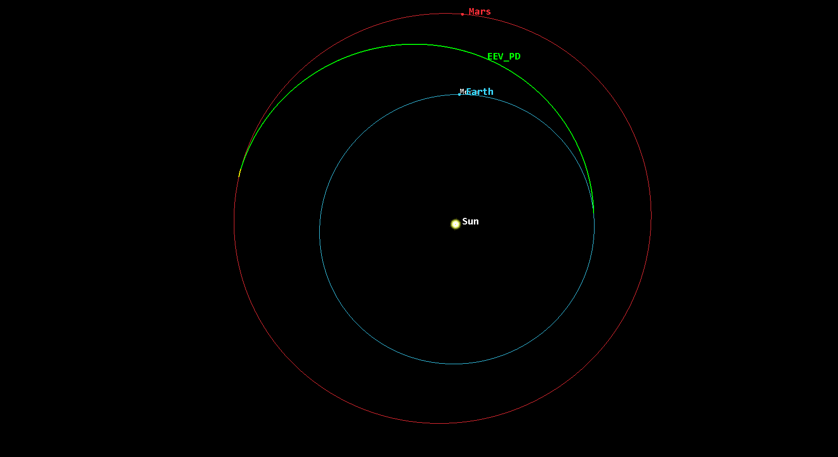
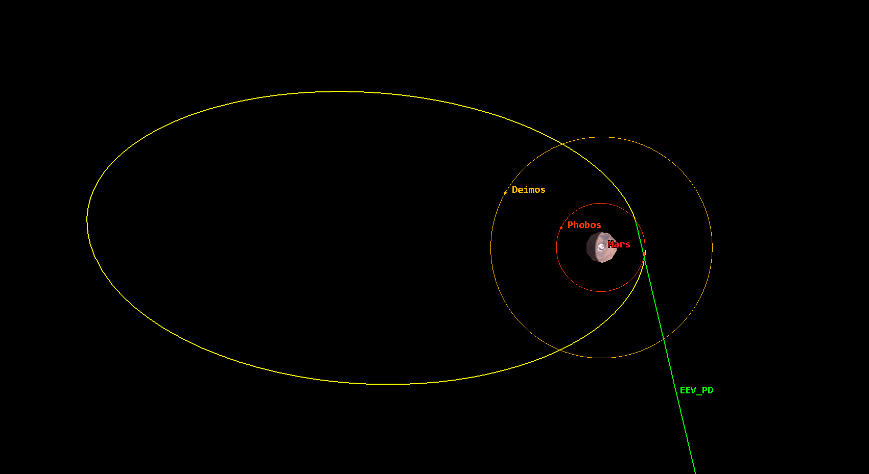
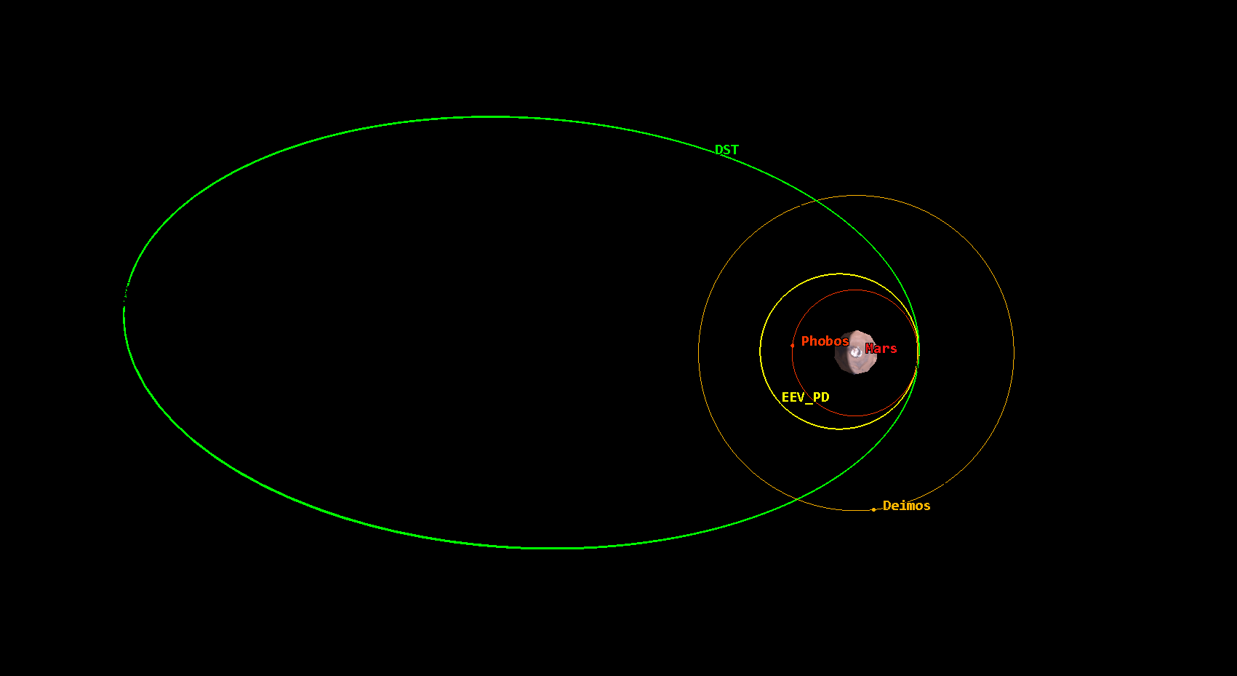
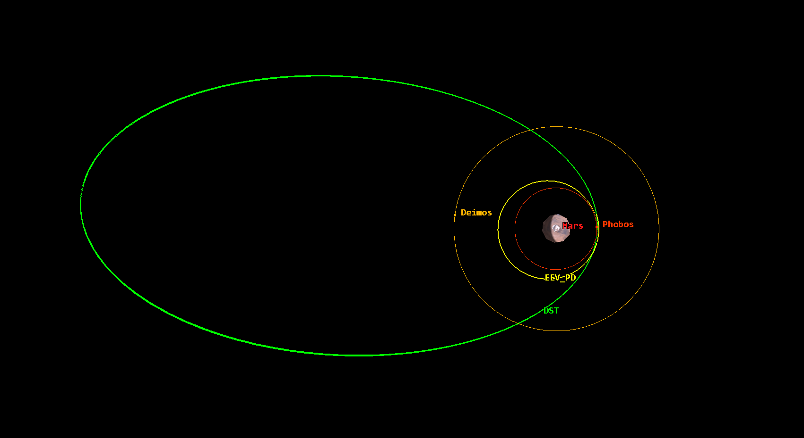
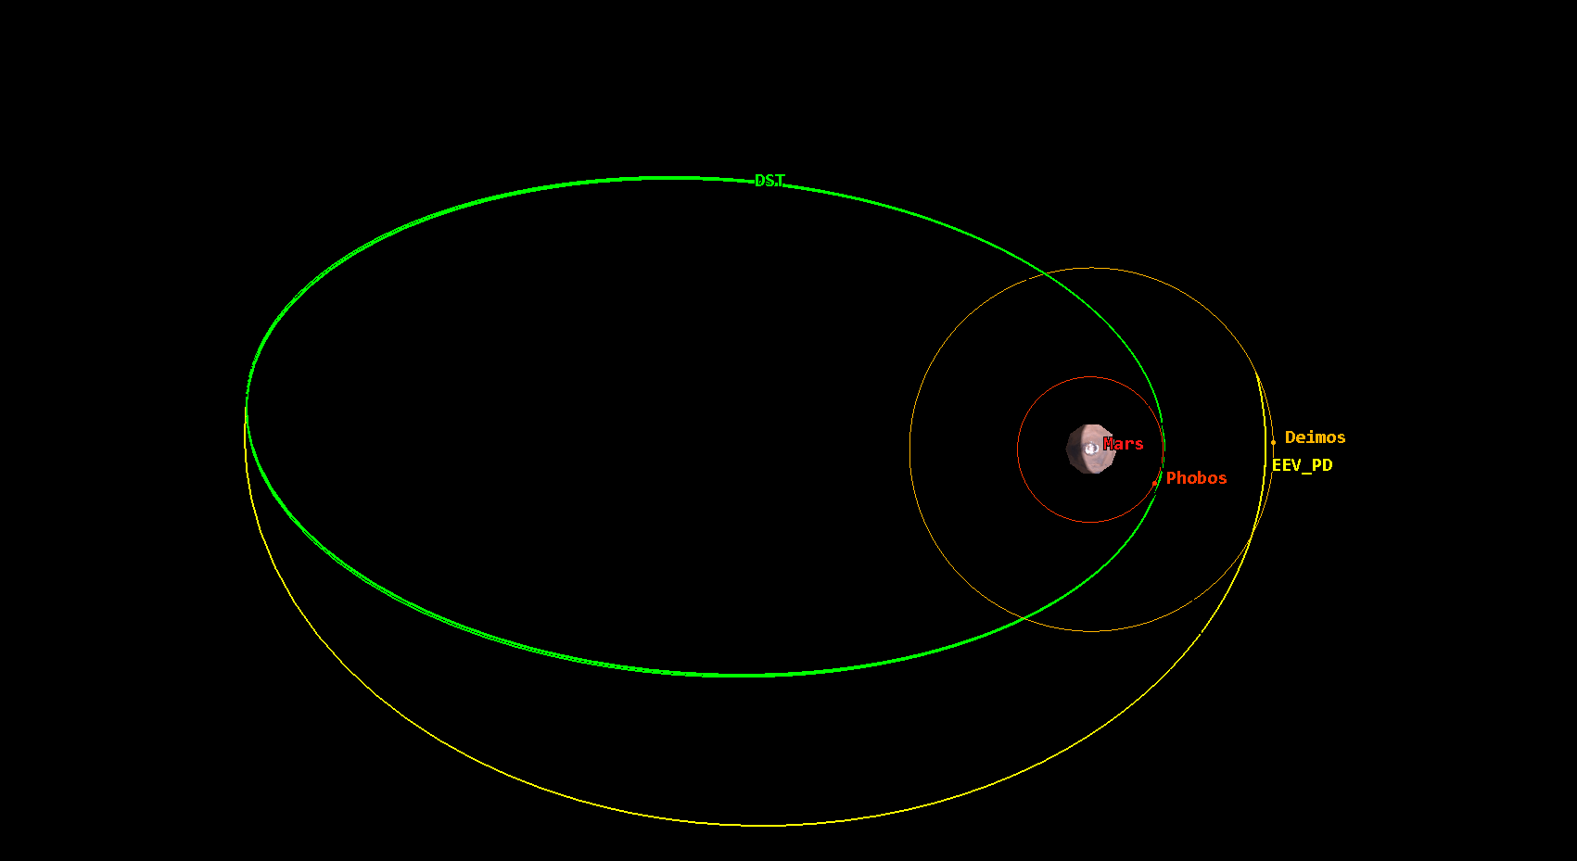
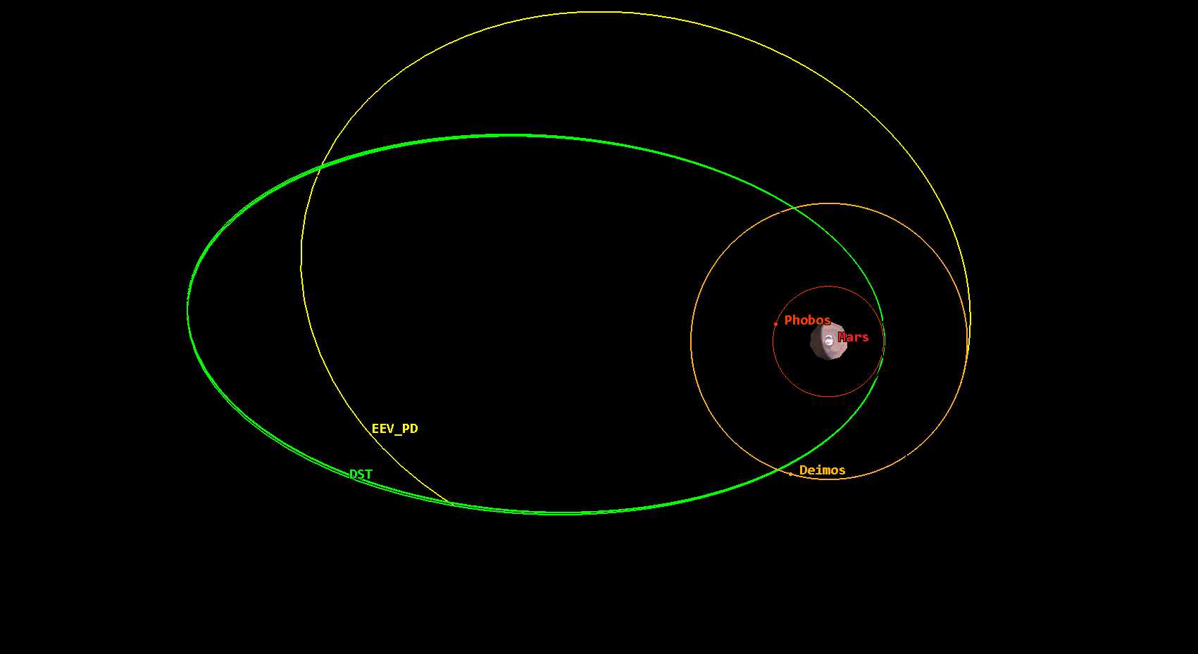
1. EEV Transfer Arc to Mars
Launch Date: Oct 9, 2039
Transfer Time: 256 days
Delta-V: 4.13 km/s
2. Mars Orbital Insertion / Parking Orbit
EEV Arrival Date: Jun 22, 2040
DST Arrival Date: Jun 27, 2040
Delta-V: 0.90 km/s
Parking Orbit Parameters:
Period: 5.0 days
Eccentricity: 0.84
SMA: 59000 km
3. Transfer to Phobos
Transfer Date: Jul 2, 2040
Time on Phobos: 9.2 days
Delta-V: 0.83 km/s
4. Return to DST
Return Date: Jul 12, 2040
Transfer Time: 11 hrs.
Delta-V: 0.90 km/s
5. Transfer to Deimos
Transfer Date: Jul 15, 2040
Time on Deimos: 4.9 days
Delta-V: 0.59 km/s
6. Return to DST
Return Date: Jul 26, 2040
Transfer Time: 4 days
Delta-V: 0.63 km/s

Slide 2
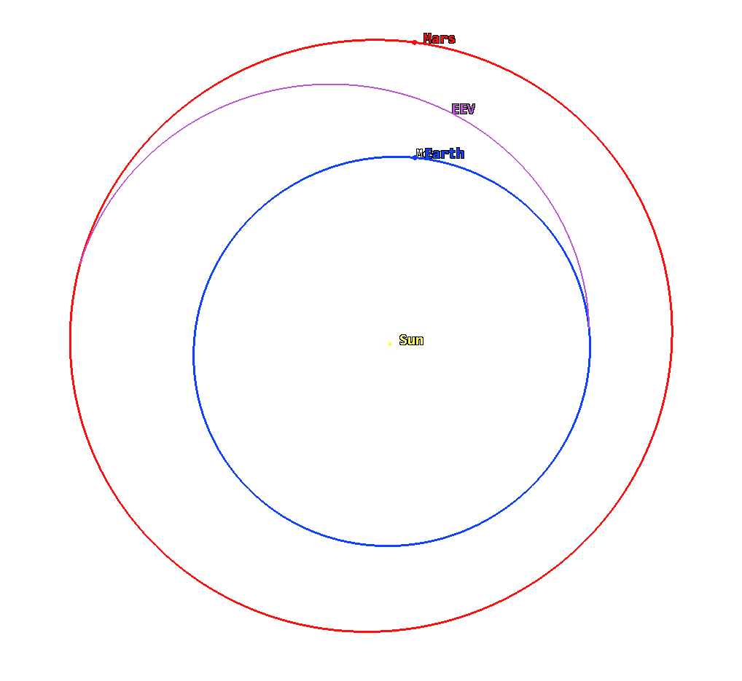
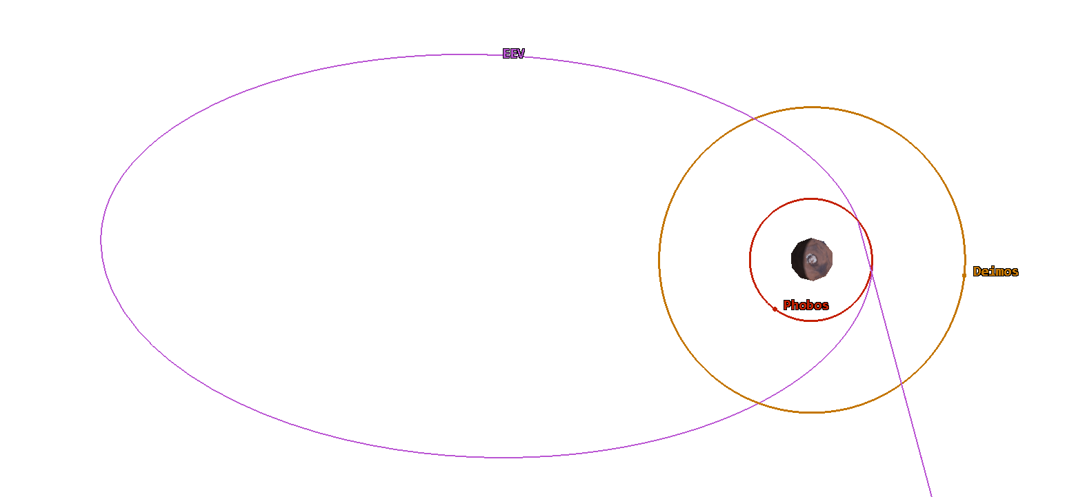
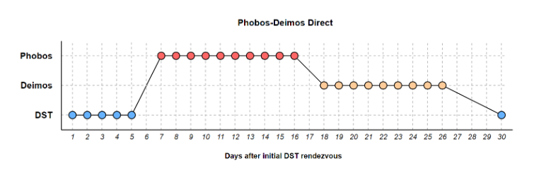
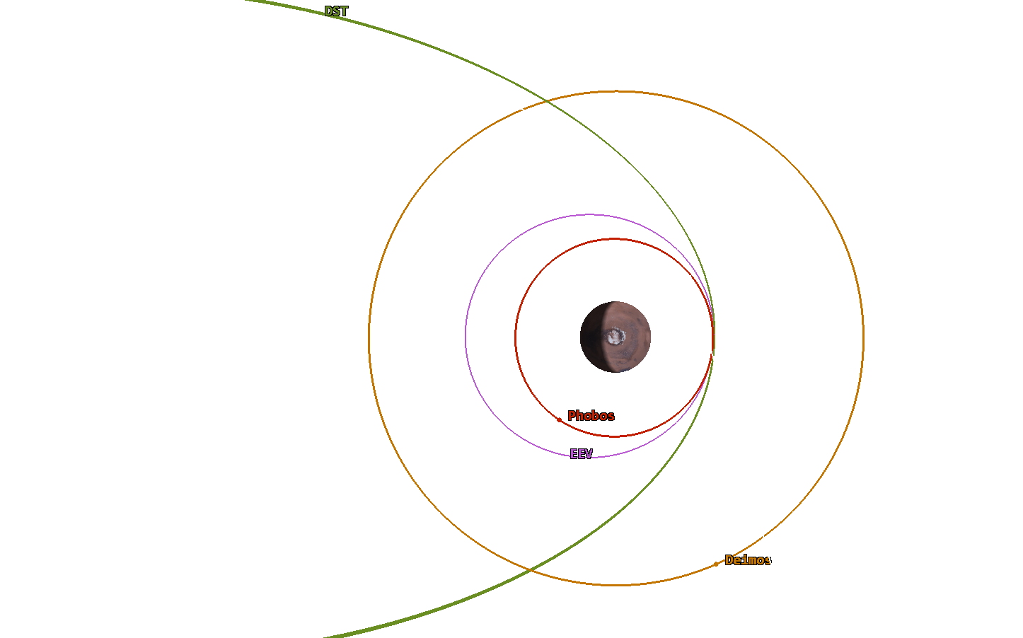
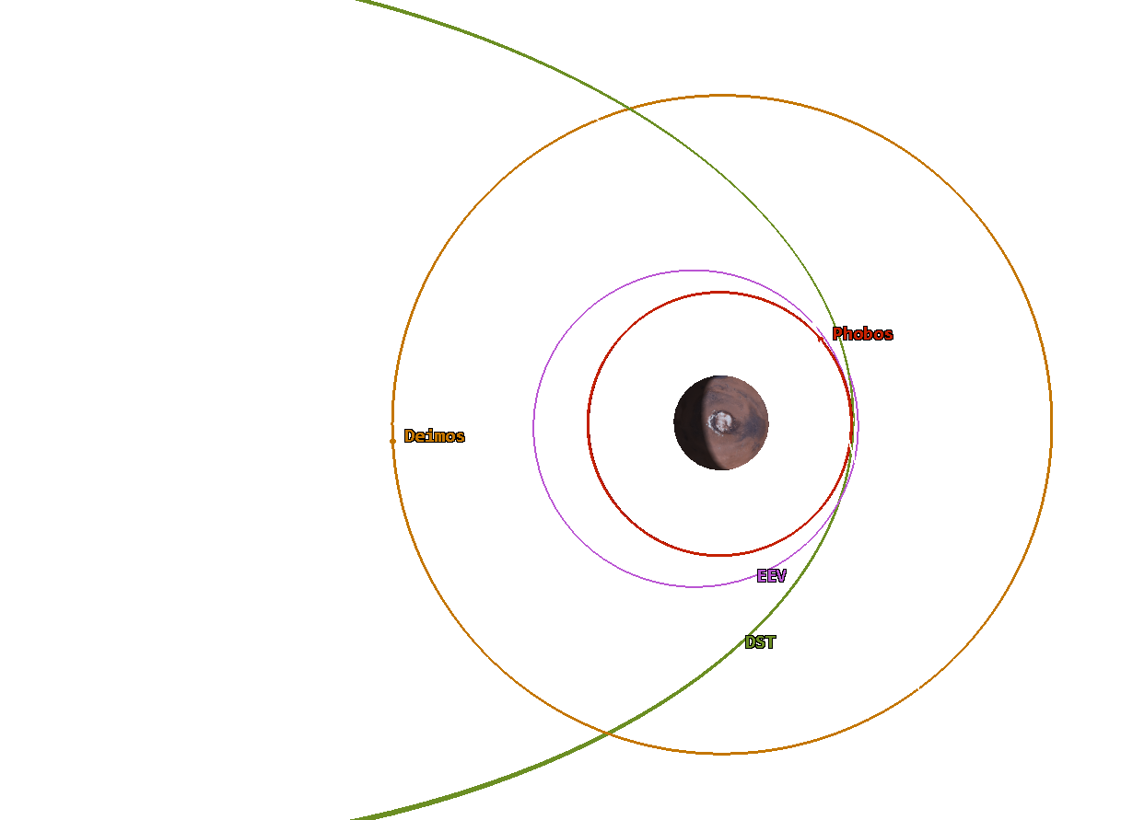
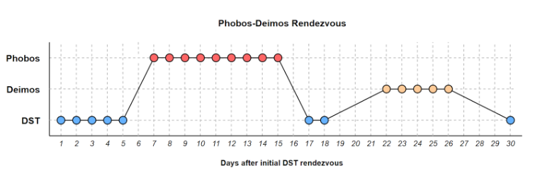
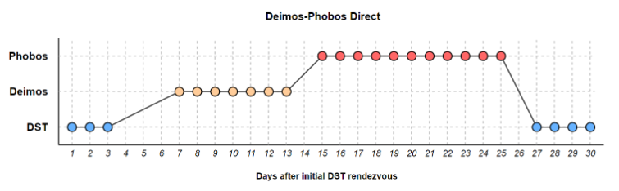
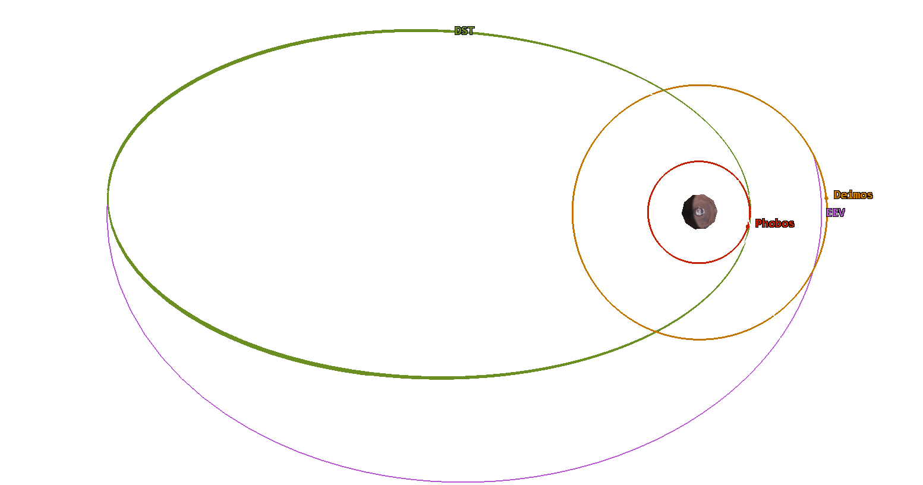
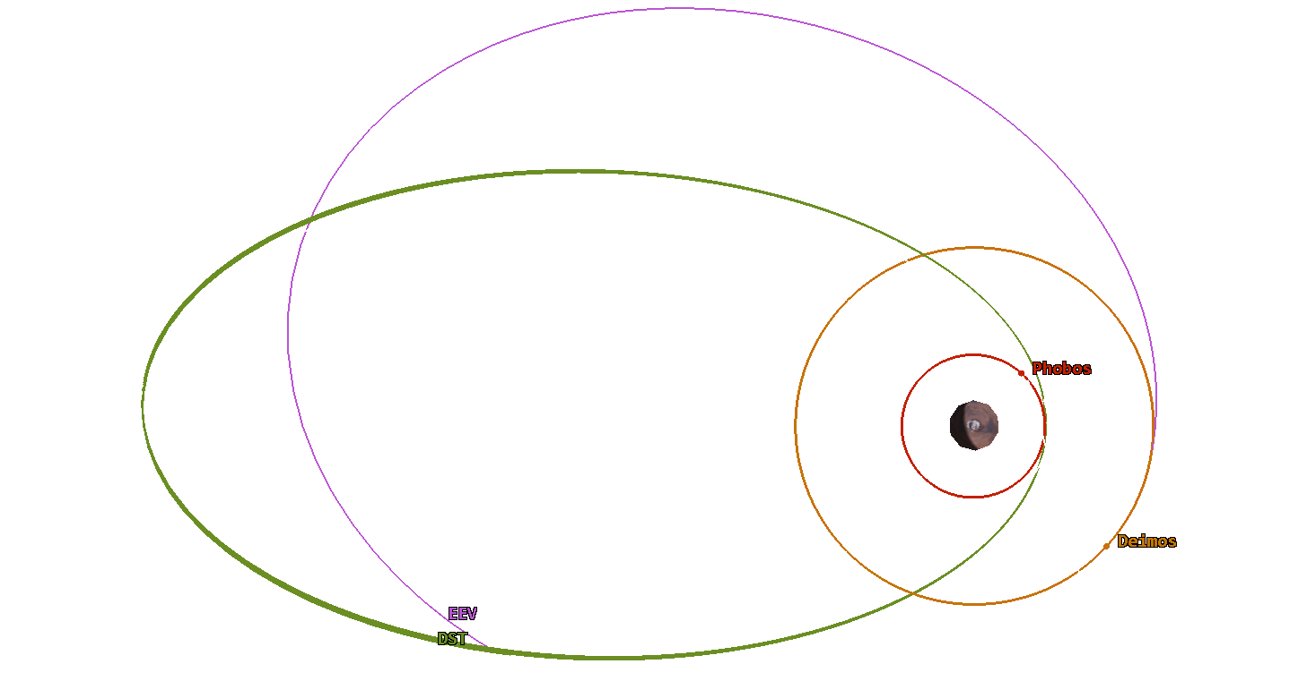
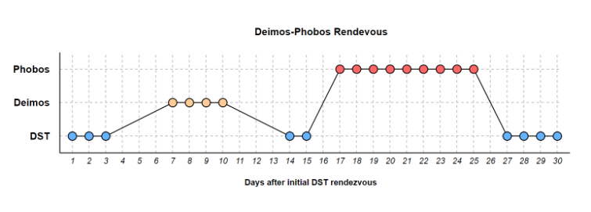
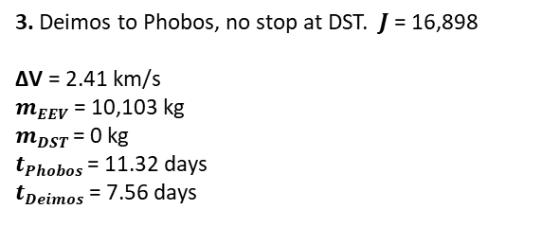

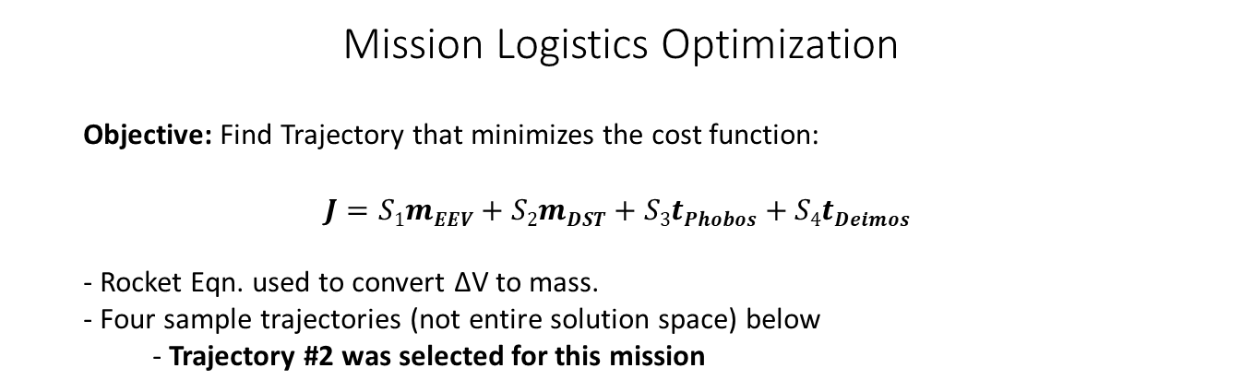
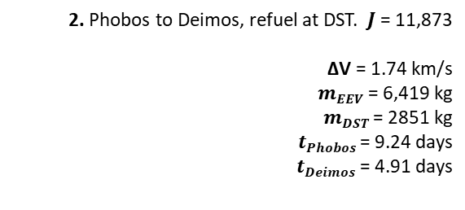
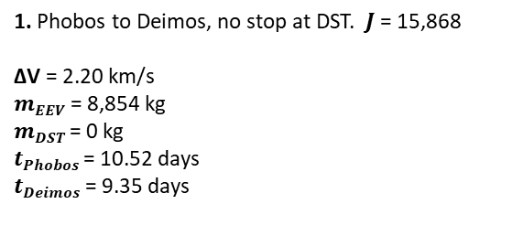
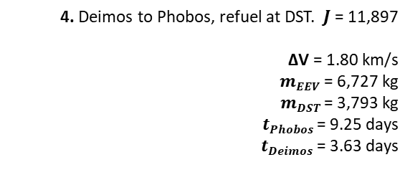
Mission Logistics Optimization
Objective: Find Trajectory that minimizes the cost function:
$$J=S1mEEV+S2mDST+S3tPhobos+S4tDeimos$$
- Rocket Eqn. used to convert ΔV to mass.
- Four sample trajectories (not entire solution space) below
- Trajectory #2 was selected for this mission
1. Transfer Arc to Mars
Launch Date: Oct 9, 2039
Transfer Time: 256 Days
ΔV: 4.13 km/s
$mEEV$ – Required propellant capacity of the EEV
$mDST$ – Required propellant from the DST
$tPhobos$ – Science time on Phobos (days)
$tDeimos$ – Science time on Deimos (days)
2. Parking Orbit Insertion
EEV Arrival Date: Jun 22, 2040
DST Arrival Date: Jun 27, 2040
ΔV: 0.90 km/s
Parking Orbit Parameters
Period: 5.0 days
Eccentricity: 0.84
SMA: 59000 km
1. Phobos to Deimos, no stop at DST. $J$ = 15,868
ΔV = 2.20 km/s
$mEEV$ = 8,854 kg
$mDST$ = 0 kg
$tPhobos$ = 10.52 days
$tDeimos$ = 9.35 days
2. Phobos to Deimos, refuel at DST. $J$ = 11,873
ΔV = 1.74 km/s
$mEEV$ = 6,419 kg
$mDST$ = 2851 kg
$tPhobos$ = 9.24 days
$tDeimos$ = 4.91 days
3. Transfer to Phobos
Transfer Date: Jul 2, 2040
Time on Phobos: 9.2 days
ΔV: 0.83 km/s
4. Return to DST
Transfer Date: Jul 12, 2040
Transfer Time: 11 hours
ΔV: 0.90 km/s
3. Deimos to Phobos, no stop at DST. $J$ = 16,898
ΔV = 2.41 km/s
$mEEV$ = 10,103 kg
$mDST$ = 0 kg
$tPhobos$ = 11.32 days
$tDeimos$ = 7.56 days
4. Deimos to Phobos, refuel at DST. $J$ = 11,897
ΔV = 1.80 km/s
$mEEV$ = 6,727 kg
$mDST$ = 3,793 kg
$tPhobos$ = 9.25 days
$tDeimos$ = 3.63 days
5. Transfer to Deimos
Transfer Date: Jul 15, 2040
Time on Deimos: 4.9 days
ΔV: 0.59 km/s
6. Return to DST
Transfer Date: Jul 26, 2040
Transfer Time: 4 days
ΔV: 0.63 km/s

Slide 3
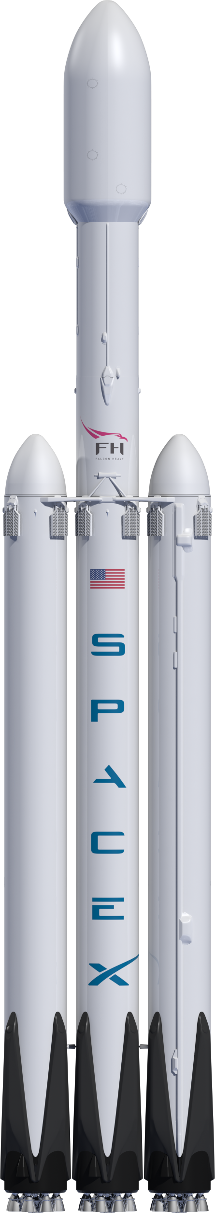

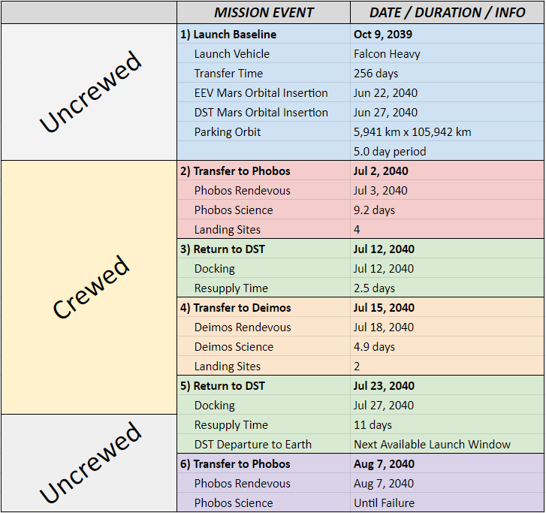
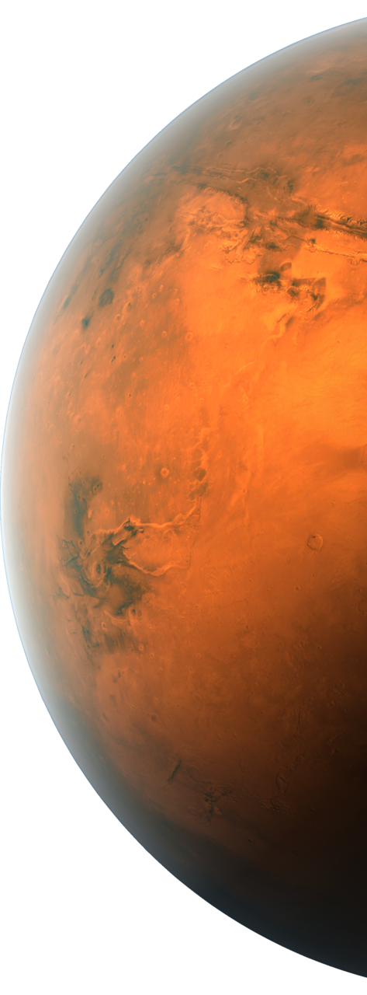
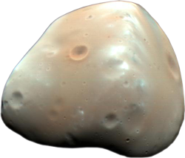
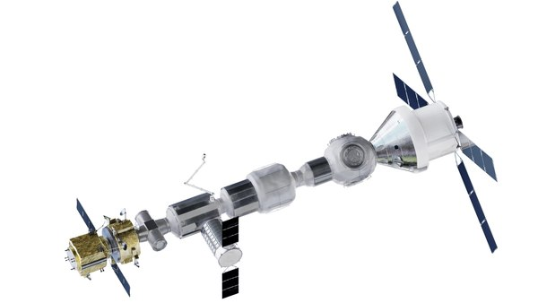
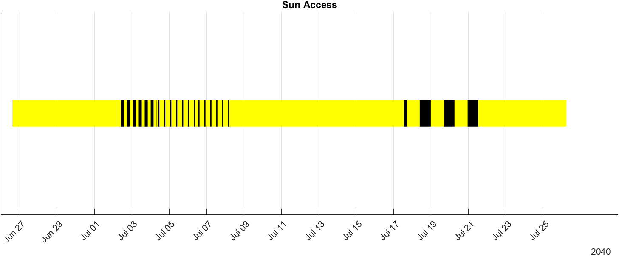
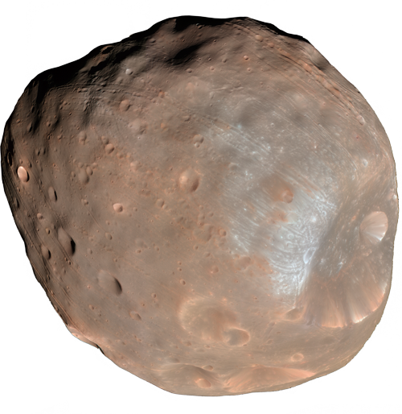
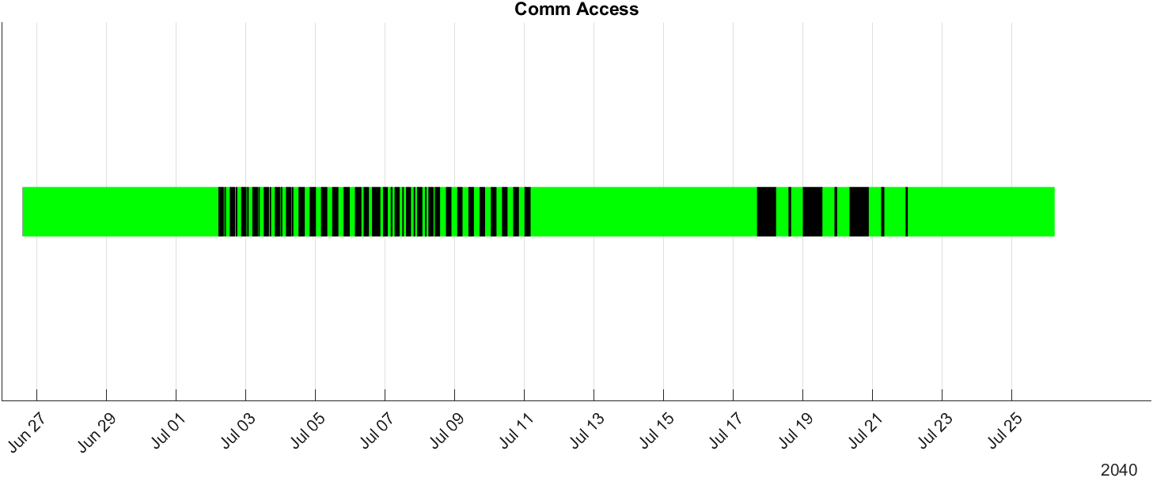
Concept of Operations
Mission Schedule
Landing Sites:
1) Swift Crafter (12.5º N 1.8º E)
2) Voltaire Crater (22.0º N 3.5º W)
Launch Vehicle: Falcon Heavy
5
1
4
Longest Eclipse: 14 hours
Longest Comm Blackout: 13 hours
3
2
6
Landing Sites:
1) Stickney Crafter (1º N 49º W)
2) Clustril Crater (60º N 91º W)
3) Flimnap Crater (60º N 10º E)
4) Gulliver Crater (81º N 165º E)
Earth Orbit
DST Orbit
Deimos Orbit
Phobos Orbit

Slide 4
Exploded Assembly

Slide 5
Surface Operations/Sampling Detail

Slide 6
P&ID? Also LSS? Close-up on ServMod

